Slide 1
Conditional Statements

Slide 2
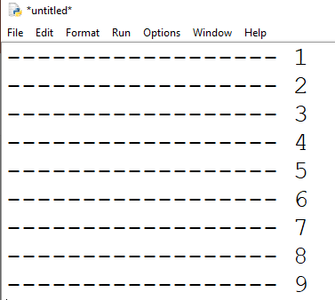
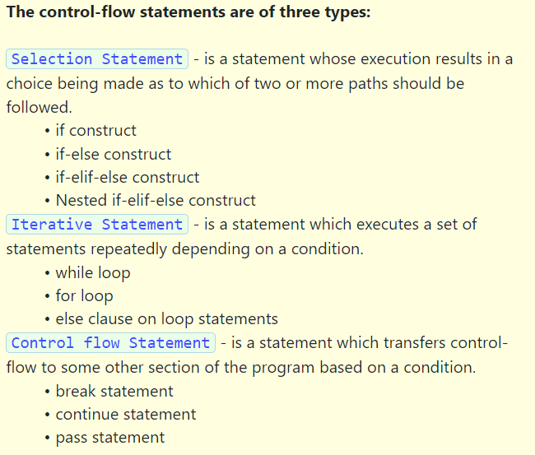
Python provides special constructs to control the execution of one or more statements depending on a condition. Such constructs are called as control statements or control-flow statements.

Slide 3
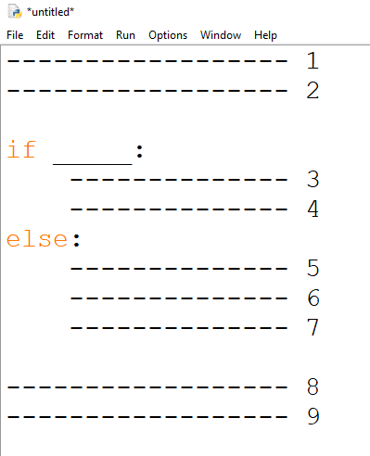

Slide 4
Take an integer as input from the console using input() function. Write a program to check the given integer is divisible by 7 or not, print the result to the console as shown in the examples.
Case 1
Sample Input and Output 1:
Enter a number: 77
Given number 77 is divisible by 7
End of program
Case 2
Sample Input and Output 2:
Enter a number: 40
End of program

Slide 5
Select the correct output for the below Python code?
a = 27
b = 27.0
if(a == b):
print("a and b are equal")
if(a != b):
print("a and b are not equal")
Interpreter Error
a and b are equal.
a and b are equal a and b are not equal
a and b are not equal.

Slide 6
Select the correct output for the below Python code?
a = 27
b = 27.0
if(a == b):
print("a and b are equal")
if(a != b):
print("a and b are not equal")
Interpreter Error
a and b are equal.
a and b are equal a and b are not equal
a and b are not equal.

Slide 7
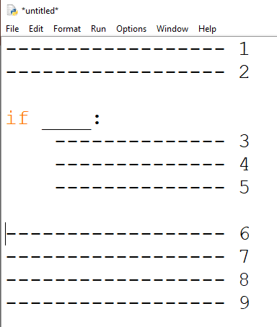
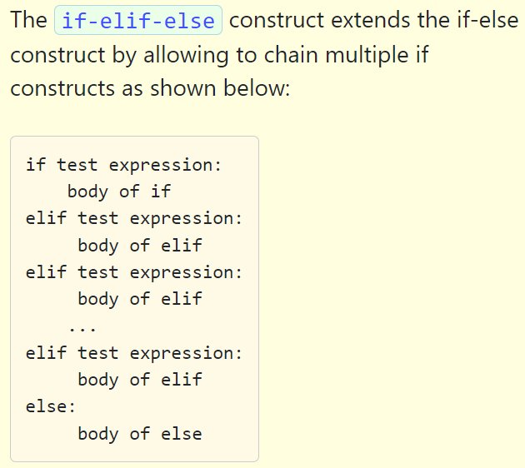

Slide 8
If Marks > 90 A
80----90 B
70----80 C
60----70 D
Marks< 60 F

Slide 9
What is the output of the following?
if (10 < 0) and (0 < -10):
print("A")
elif (10 > 0) or False:
print("B")
else:
print("C")
A: A
B: B
C:C
D: Error
Notes:
Ans B

Slide 10
Predict output of the following python program. a, b, c = 5, 1, 15 if (a < b) and (a < c): print("A is minimum") elif (b < a) and (b < c): print("B is minimum") else: print("C is minimum")
A: A is minimum
B: B is minimum
C:C is minimum
D: Error
Notes:
Ans B

Slide 11
Important Points:
The if elif else construct is used when we have multiple mutually exclusive expressions.
If the condition for if is false, then the condition for the next elif is evaluated and so on upto the next elif.
If all the conditions are false, then the body of else is executed.
Only one block among if elif else blocks is executed based on the condition.
The if block can have only one else block, but it can have multiple elif blocks.
Indentation is used for each of the if-elif-else blocks

Slide 12
Practice Programs:
1. Write a program to calculate the electricity bill, we must understand electricity charges and rates.
1 - 100 unit - 1.5/-
101-200 unit - 2.5/-
201-300 unit - 4/-
300 - 350 unit - 5/-
above 350 - 15 /-
2. Write a program that prompts the user to enter a weight in pounds and height in inches and then displays the BMI.
Note that one pound is 0.45359237 kilograms and one inch is 0.0254 meters. Use ladder if concept.
if bmi < 18.5
print("Underweight")
if bmi < 25
print("Normal")
if bmi < 30
print("Overweight")
else
print("Obese")
bmi = weightInKilograms / (heightInMeters * heightInMeters)

Slide 13
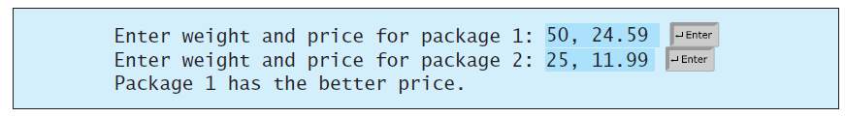
3. Suppose you shop for rice and find it in two different sized packages. You would like to write a program to compare the costs of the packages. The program prompts the user to enter the weight and price of each package and then displays the one with the better price. Here is a sample run:
4. Write a Python program to check a triangle is equilateral, isosceles or scalene.
Note :An equilateral triangle is a triangle in which all three sides are equal. A scalene triangle is a triangle that has three unequal sides. An isosceles triangle is a triangle with (at least) two equal sides.

Slide 14
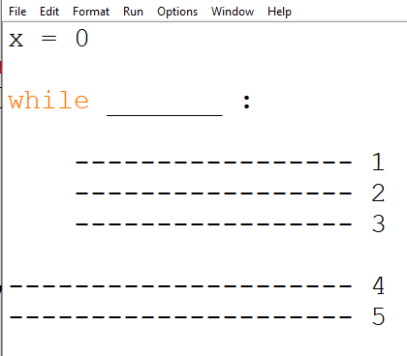
While Loop
A while statement is used to execute some block of code repeatedly as long as a condition evaluates to True. In the While loop, the value of the expression is evaluated first.
The body of the loop is entered only when the expression evaluates to true.
After one iteration, the expression is checked again.
This process continues until the expression evaluates to False.
The body of the loop is identified using the indentation with the expression condition as the first statement.

Slide 15
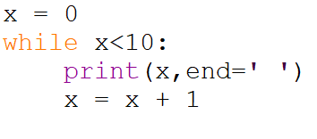


Slide 16
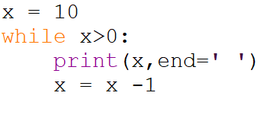

Slide 18
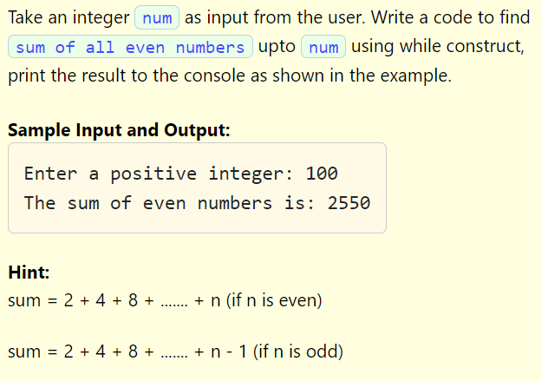

Slide 19
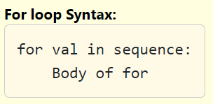
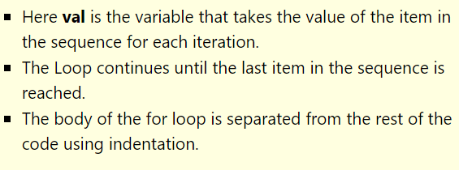
For Loop
A for-loop is used to iterate over a range of values using a loop counter, which is a variable taking a range of values in some orderly sequence (e.g., starting at 0 and ending at 10 in increments of 1). The value stored in a loop counter is changed with each iteration of the loop, providing a unique value for each individual iteration. The loop counter is used to decide when to terminate the loop. A for-loop construct can be termed as an entry controlled loop.

Slide 20
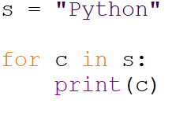


Slide 21
Range Function
Range returns an immutable sequence objects of integers between the given start integer to the stop integer.
range() constructor has two forms of definition:
range(stop)
range(start, stop, step)
start - integer starting from which the sequence of integers is to be returned
integer before which the sequence of integers is to be returned. The range of integers end at stop - 1.
step (Optional) - integer value which determines the increment between each integer in the sequence

Slide 22
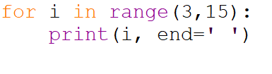
Range function:
range(10) ---→ 0 1 2 3 4 5 6 7 8 9
range(1,5) → 1 2 3 4
range(1,10,2) → 1 3 5 7 9
range(0, -10, -3) → 0 -3 -6 -9

Slide 23
Q1. for i in range(1,8,2)
Second element
A)1
B)5
C)3

Slide 24
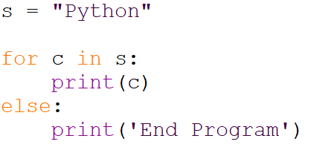
For loop with else
A for loop can have an optional else block as well.
The else part is executed if the items in the sequence used in for-loop exhausts.
A break statement can be used to stop a for-loop. In such case, the else part is ignored.
Hence, a for-loop's else part runs if no break occurs.

Slide 25
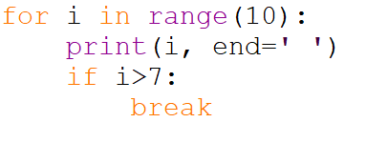
Break
Break is used to terminate the loop

Slide 26
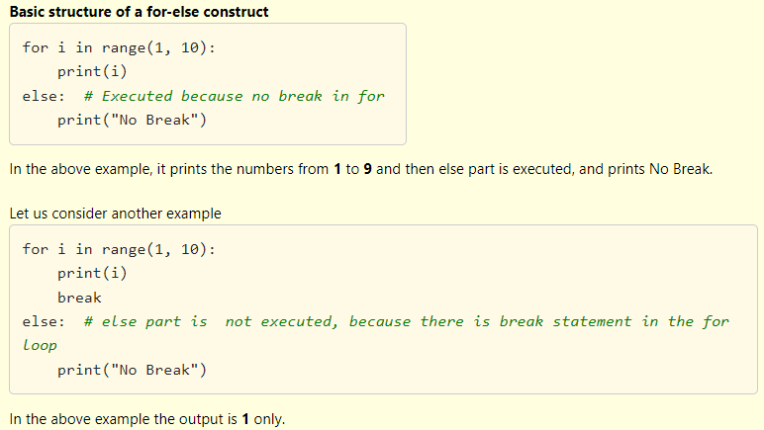

Slide 27
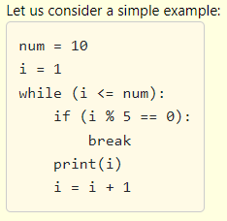
Break
Loops iterate over a block of code until test expression is False, but sometimes we wish to terminate the current iteration or even the whole loop without checking test expression.
The break statement terminates the loop containing it. Control of the program flows to the statement immediately after the body of the loop.
If break statement is inside a nested loop (loop inside another loop), break will terminate the innermost loop.

Slide 28
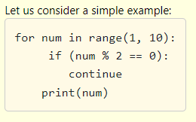
Continue Statement
The continue statement is used to skip the rest of the code inside a loop of the current iteration. Loop does not terminate but continues with the next iteration.

Slide 29
Exercise
Sum of digit
Reverse the number
Palindrome Number
Armstrong Number
Perfect Number
GCD
Write a password guessing program to keep track of how many times the user has entered the password wrong. If it is more than 3 times, print "You have been denied access." and terminate the program. If the password is correct, print "You have successfully logged in." and terminate the program.

Slide 30
Exercise
Write a password guessing program to keep track of how many times the user has entered the password wrong. If it is more than 3 times, print "You have been denied access." and terminate the program. If the password is correct, print "You have successfully logged in." and terminate the program.
Write a program that asks for two numbers. If the sum of the numbers is greater than 100, print "That is a big number" and terminate the program.
Write a Python program that accepts a number from the user and reverse it.
Write a python program to find those numbers which are divisible by 7 and multiples of 5, between 1500 and 2700.

Slide 31
Write a Python program which iterates the integers from 1 to 50. For multiples of three print "Fizz" instead of the number and for the multiples of five print "Buzz". For numbers which are multiples of both three and five print "FizzBuzz“
Write a Python program to check a triangle is equilateral, isosceles or scalene. Note :An equilateral triangle is a triangle in which all three sides are equal. A scalene triangle is a triangle that has three unequal sides. An isosceles triangle is a triangle with (at least) two equal sides.
Write a Python program to check whether an alphabet is a vowel or consonant.

Slide 32
Break
i = 1
while i < 6:
print(i)
if (i == 3):
break
i += 1

Slide 33
Continue
i = 0
while i < 6:
i += 1
if i == 3:
continue
print(i)

Slide 34
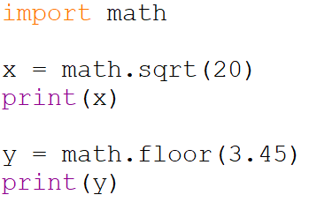
Mathematical Functions
Python has numerous mathematical functions. The full list can be found at Mathematical Functions To perform mathematical functions we have to import math module. The math module contains mathematical functions and mathematical constants. Most of the mathematical functions are available in math module except min(), max(), abs(), pow(), round().

Slide 35
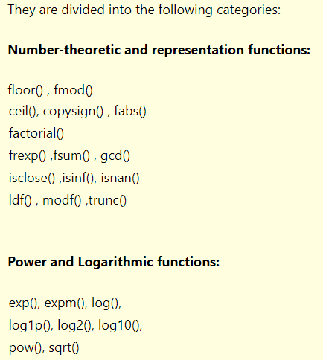

Slide 36
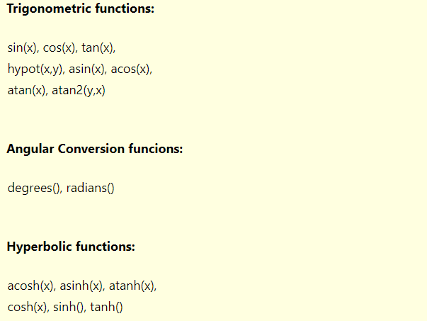

Slide 37
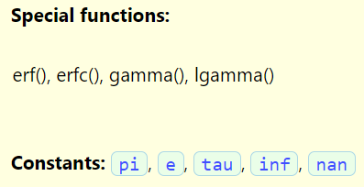

Slide 38
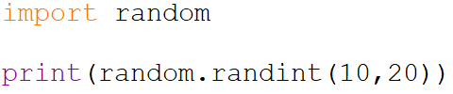
Random Module
Python provides us random number functions. We use these random numbers in areas like research, games, cryptography, simulation and other applications. We have to import random module to use random functions.

Slide 39
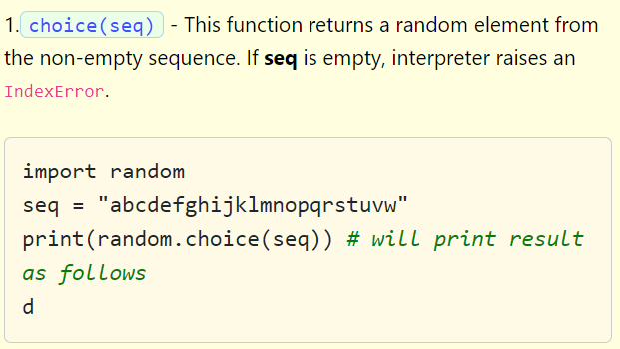

Slide 40
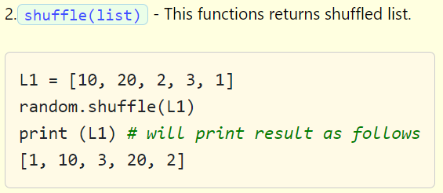

Slide 41
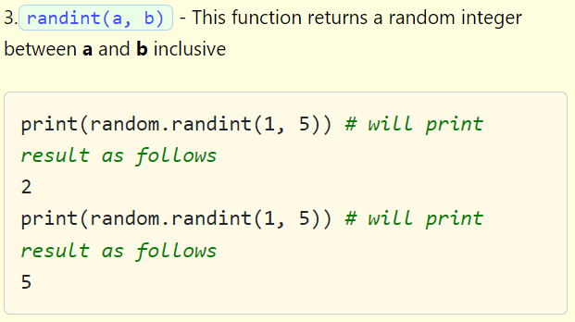

Slide 42
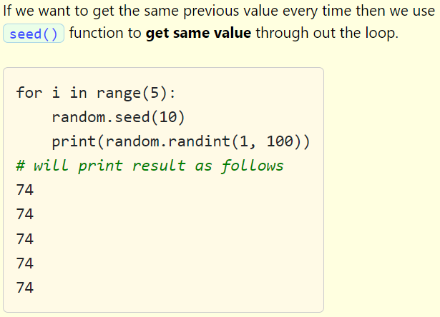

Slide 43
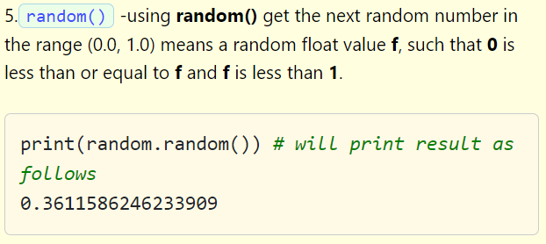

Slide 44
